Slide 1
Created by:
Ms. Sappington
4th grade

Slide 2
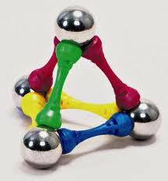
I can decide if electrically charged objects interact with other objects.

Slide 3
Compass
A tool that uses Earth’s magnetic field to show direction.

Slide 4
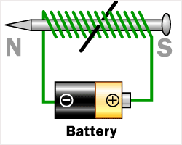
Electromagnet
An electrical circuit that produces a magnetic field.

Slide 7
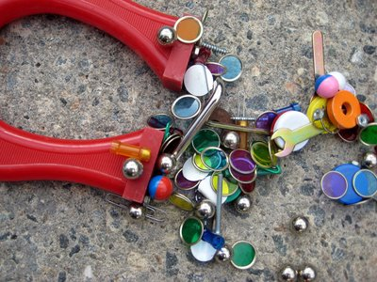
Magnetic Attraction
The attraction caused by a magnetic force.

Slide 8
Magnetic Field
The region of force around a magnet

Slide 9
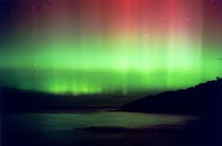

Slide 10
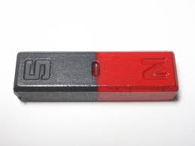
Pole
A device that uses Earth’s magnetic field to find direction

Slide 11
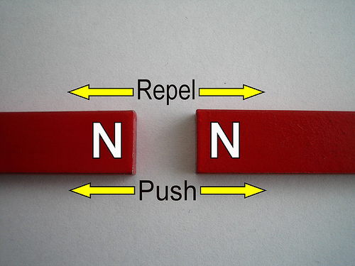
Repel
What happens when like poles are placed near each other

Slide 12
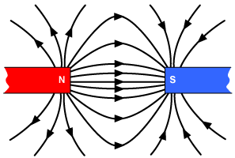
The pull of a magnet is strongest at its poles.

Slide 13
Attract: pull together

Slide 16
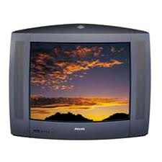
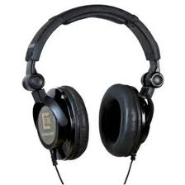
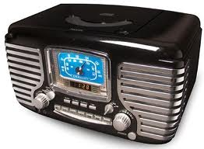
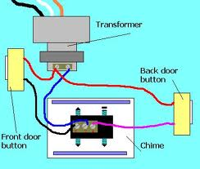
Electromagnets are important parts of speakers in radios, televisions, headphones, telephones, and microphones. A doorbell also uses electromagnets.

Slide 17
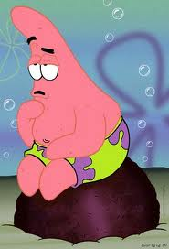
While working on today’s lesson, think about what daily life would be like without magnets…
HMMMMMMM???

Slide 18
What will make a magnet move?
Item
Yes
No
Pencil
Paper Clip
Penny
Marble
Scissors
Nail
Yarn
Button

Slide 19
